Slide 1
Simulated Annealing
Some slides adapted from By Rohit Ray and Jaap Hoftede

Slide 2
The Problem
Most minimization (maximization) strategies work to find the nearest local minimum
Trapped at local minimums (maxima)
Standard strategy
Generate trial point based on current estimates
Evaluate function at proposed location
Accept new value if it improves solution

Slide 3
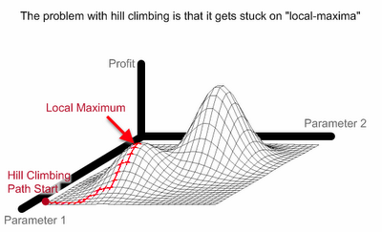
Example: Hill Climbing
Look around at states in the local neighborhood and choose the one with the best value
Taken from www.maxdama.com
Notes:
We don’t know where the global max is.

Slide 4
Solution
A new strategy must be developed to discover other minimum
This involves evaluating a functions at points that don’t necessarily improve the solution
Repeat algorithm many times with different initial configurations
Use information gathered in previous runs
Use a more complex Generation Function to jump out of local optimum
Use a more complex Evaluation Criterion that accepts sometimes (randomly) also solutions away from the (local) optimum

Slide 5
Simulated Annealing
Inspired from ancient process of forging iron
Annealing refers to the fast heating of a metal and then cooling it slowly
The method was first proposed by Metropolis (1953)
Monte-Carlo methods
P=(-∆E/kT)
Kirkpatrick et al. (1982) later improved the SA method applied optimization problems

Slide 6
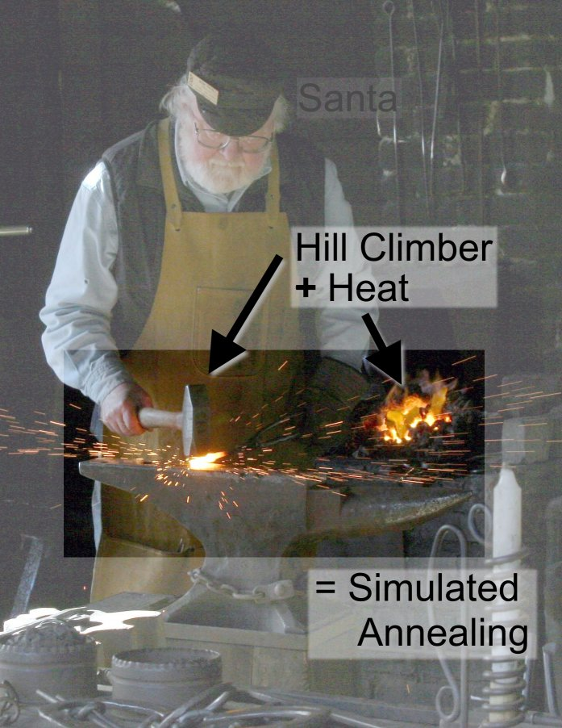
Simulated Annealing
Taken from www.maxdama.com

Slide 7
Simulated Annealing
High temperature→ High Disorder → High Energy
SA differs from hill climbing in that a move is selected at random and then decides whether to accept it
In SA better moves are always accepted. Worse moves are not

Slide 8
Simulated Annealing
The probability of accepting a worse state is a function of both the temperature of the system and the change in the cost function
As the temperature decreases, the probability of accepting worse moves decreases
If T=0, no worse moves are accepted (i.e. hill climbing)

Slide 9
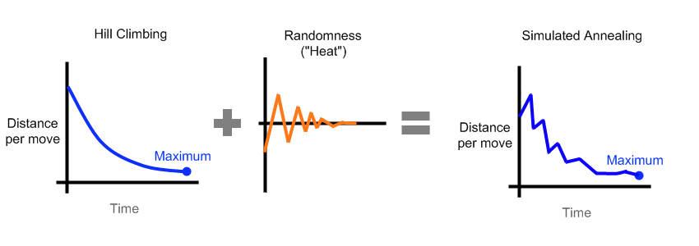
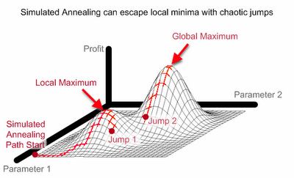
Simulated Annealing
Taken from www.maxdama.com

Slide 10
SA: Starting Temperature
Must be hot enough to allow moves to almost every neighborhood state
Must not be so hot that we conduct a random search for a long period of time
Problem is finding a suitable starting temperature

Slide 11
SA Algorithm
Choose an initial value for T and a random initial solution x
Update T
Generate a new solution s
Is Mx > Mxs or
Rand<exp((Mx-Msx)/T)
No
Yes
Replace x with s
Is termination condition met?
No
Yes
End

Slide 12
SA Advantages/Disadvantages
Advantages
Guaranteed to find optimum
Avoids being trapped at local minimums
Disadvantages
No time constraints
Not faster than many contemporaries

Slide 13
Performance
SA is a general solution method that is easily applicable to a large number of problems
"Tuning" of the parameters (initial c, decrement of c, stop criterion) is relatively easy
Generally the quality of the results of SA is good, although it can take a lot of time
Results are generally not reproducible: another run can give a different result
SA can leave an optimal solution and not find it again (so try to remember the best solution found so far)
Proven to find the optimum under certain conditions; one of these conditions is that you must run forever

Slide 14
Works Cited
www.sph.umich.edu/csg/abecasis/class/2006/615.19.pdf
http://www.maxdama.com/2008/07/trading-optimization-simulated.html
www.intelligentmodelling.org.uk
https://www.mii.lt/zilinskas/uploads/Heuristic%20Algorithms/Lectures/Lect5/sa2.ppt

